Slide 1
German University in Cairo Faculty of Engineering and Materials Science Mechatronics Engineering Department Backup Roll Balancing
Project(3)
Presented by: Mohamed Hassan Elattar Supervised by: Dr. Eng. Taher Salah El-Din
Notes:
Good Morning, I am Abdallah Hossam and today I am going to present to you my Masters seminar presentation, with the title $μ$-synthesis Based Control for Quad-rotor UAV in the presence of non-parametric and unstructured uncertainties.

Slide 2
Outline
Introduction
Mechanism Description
Cylinder Force Calculation
Hydraulic Circuit Design
Notes:
This presentation is organized as shown. First, it is stated why robust control is required for quad-rotors, then a literature review of H-infinity based quad-rotor control is provided. Afterwards, the controller design is explained in detail. Then, simulation results are presented, and finally, the conclusion and future work are provided.

Slide 3
Outline
Introduction
Mechanism Description
Cylinder Force Calculation
Hydraulic Circuit Design
Notes:
Let us start with the introduction.

Slide 4
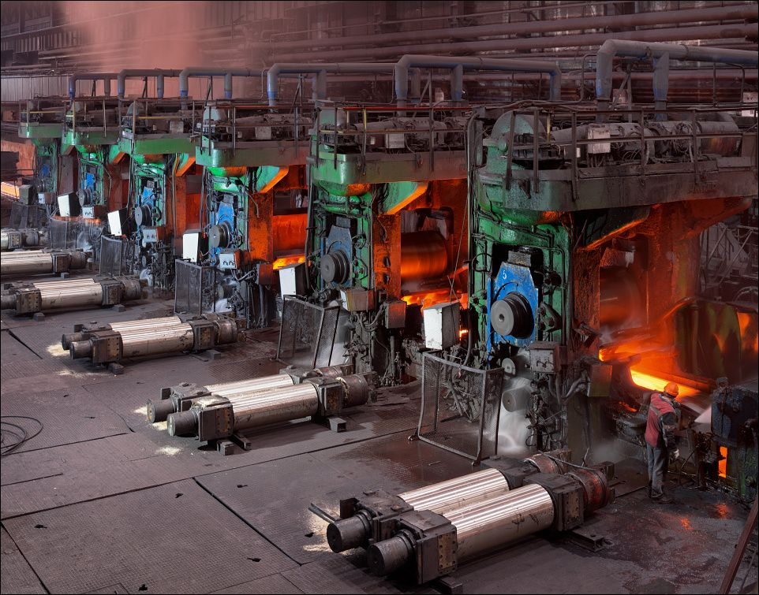
Introduction
Introduction
Introduction
Mechanism Description
Backup Roll Balancing
Stabilize Backup Rolls: Maintain the desired position and alignment of the rolls to avoid uneven pressure and material defects.
Support Roll Weight: Offset the weight of the backup roll assembly, including thrust plates, balancing systems, and gap cylinders.
Enhance Performance: Improve the efficiency and longevity of the rolling mill by reducing stress on mechanical components.
Cylinder Force
Calculation
Hydraulic Circuit Design
4

Slide 5
Outline
Introduction
Mechanism Description
Cylinder Force Calculation
Hydraulic Circuit Design
Notes:
Let us start with the introduction.

Slide 6
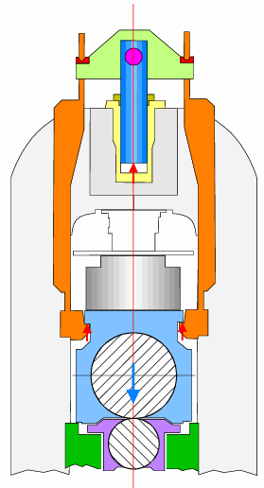
Mechanism Description
Introduction
Introduction
Key Systems components:
6 Balancing Cylinders: Provide upward force to balance the load
Hydraulic Circuit: Supplies and regulates hydraulic pressure for cylinder operation
Control Valves: Include servo valves and pressure relief valves for precise pressure adjustment and safety
Mechanism Description
Cylinder Force
Calculation
Hydraulic Circuit Design
6

Slide 7
Outline
Introduction
Mechanism Description
Cylinder Force Calculation
Hydraulic Circuit Design
Notes:
Let us start with the introduction.

Slide 8
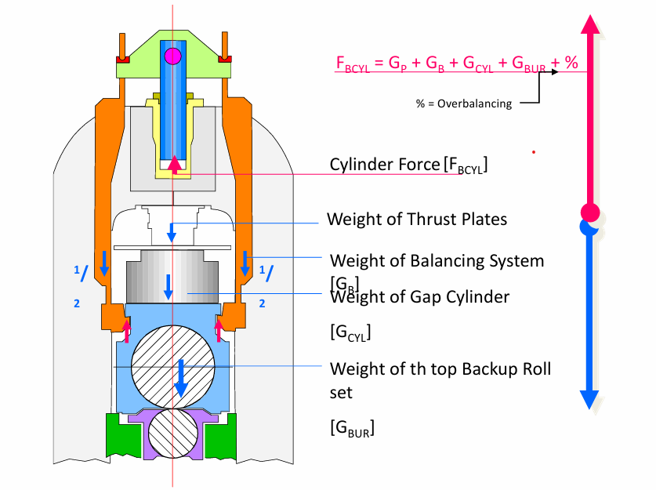
Cylinder Force Calculations
Introduction
Introduction
Mechanism Description
Cylinder Force
Calculation
Hydraulic Circuit Design
8

Slide 9
Outline
Introduction
Mechanism Description
Cylinder Force Calculation
Hydraulic Circuit Design
Notes:
Let us start with the introduction.

Slide 10
Hydraulic Circuit Design
Introduction
Introduction
The system operates under high pressures (80–290 bar) using the following components:
Main Pump: Supplies hydraulic fluid.
Pressure Filter: Ensures clean fluid for system longevity.
Relief Valve: Prevents overpressure damage.
Check Valves: Regulate flow direction and system safety.
Servo Valve: Precisely controls fluid flow and pressure to the cylinders.
Pressure Reducing Valve: Maintains the desired pressure for specific components.
Mechanism Description
Cylinder Force
Calculation
Hydraulic Circuit Design
10

Slide 11
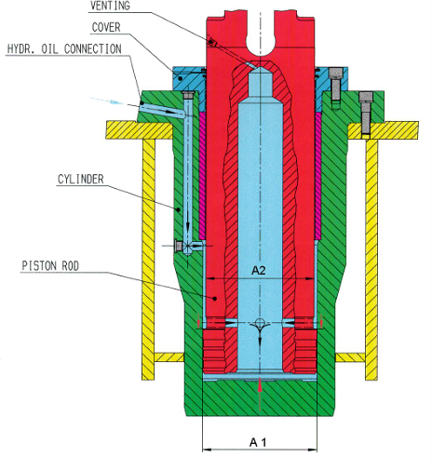
Calculations
Formula for Cylinder Speed:
V=Q/Aef
where:
V: Speed of the cylinder (m/s)
Q: Flow rate (m³/s)
Aef: Effective area (m²)
Effective piston area:
Expansion mode:
Aef=A1= π(D/2)² = 0.1134 m²
D:piston diameter
Collapse mode:
Aef=A1-A2= π(D/2)² - π(d/2)² = 0.0116 m²
d:rod piston diameter

Slide 12
Calculations
Results
Po = 70 bar, Qo = 600L/min and (y=ymax)
Speed during expansion: 0.0882 m/s
Speed during collapse: 0.8603 m/s

Slide 13
Thank you

